Slide 1
Lecture 6
Production Possibility Curves

Slide 2
Production Possibility Curves
Also known as Production Possibility Frontiers or Production possibility boundaries
Shows the combination of production of two goods that are possible with the same set of inputs.
Given same amount of money and labor available, many products could be produced.

Slide 3
Example
Farmer with a given amount of land, ecological conditions and labor /skills can grow many crops . Each will give a specified output. He could also partition the land and his time and produce various combinations of crop A and crop B. The graph of quantities of Crop A and Crop B is the PPC

Slide 4
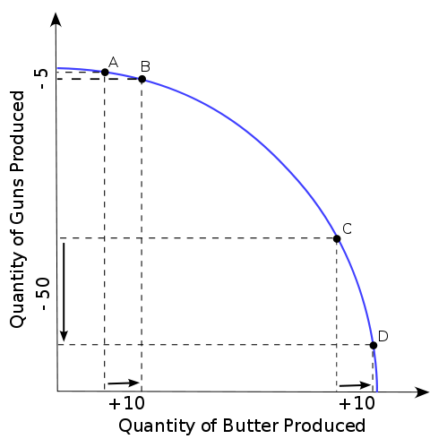

Slide 5
PPC
Measures allocative efficiencies , important since resources are limited.
Provides a measure of opportunity cost
Economies of scale

Slide 6
PPC issues for discussion
Should the curve be always concave ?
Production efficiencies and Paretto efficiencies
Paretto principle is that nobody is worse off than before and at least one person is better off

Slide 7
Pareto efficiency
Pareto efficiency is said to occur when it is impossible to make one party better off without making someone worse off.
Pareto efficiency will occur on a production possibility frontier. When an economy is operating on a simple production possibility frontier, it is not possible to increase output of goods without reducing output of services

Slide 8
Marginal rate of Transformation
It is the amount of additional units good B that can be produced by sacrificing one unit of good A. This is the slope of PPC at a point and it changes as one moves from one combination to another.

Slide 9
Marginal rate of Substitution
It is consumer centric
It is the rate of how much of good A a consumer is willing to forego for consuming an additional unit of good B
How many hours of Facebook a person is willing to forego to do an assignment in a course?
on indifference curve??

Slide 10
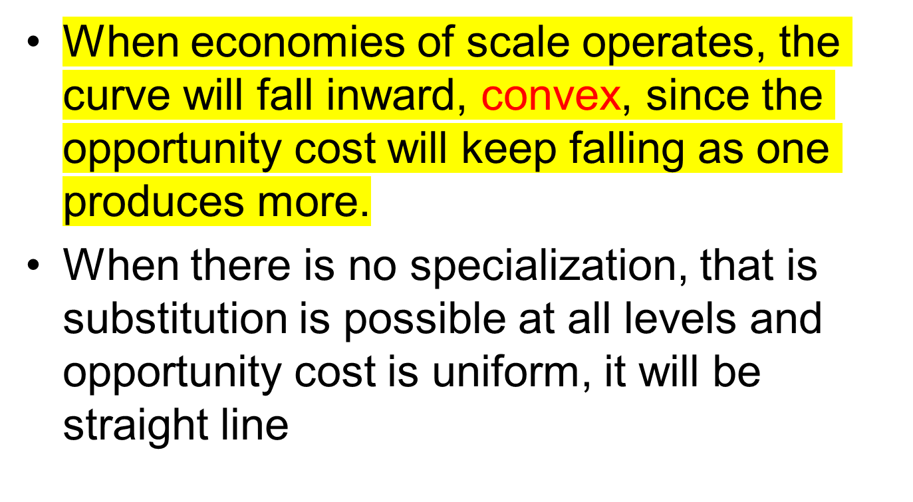
Shape of curves

Slide 11
Discuss
Impact of technological advances of PPC
What happens when there is economic growth

